Slide 1
Quantum computing benchmarks and quantum noise mitigation
Rajesh Sathya Kumar

Slide 2
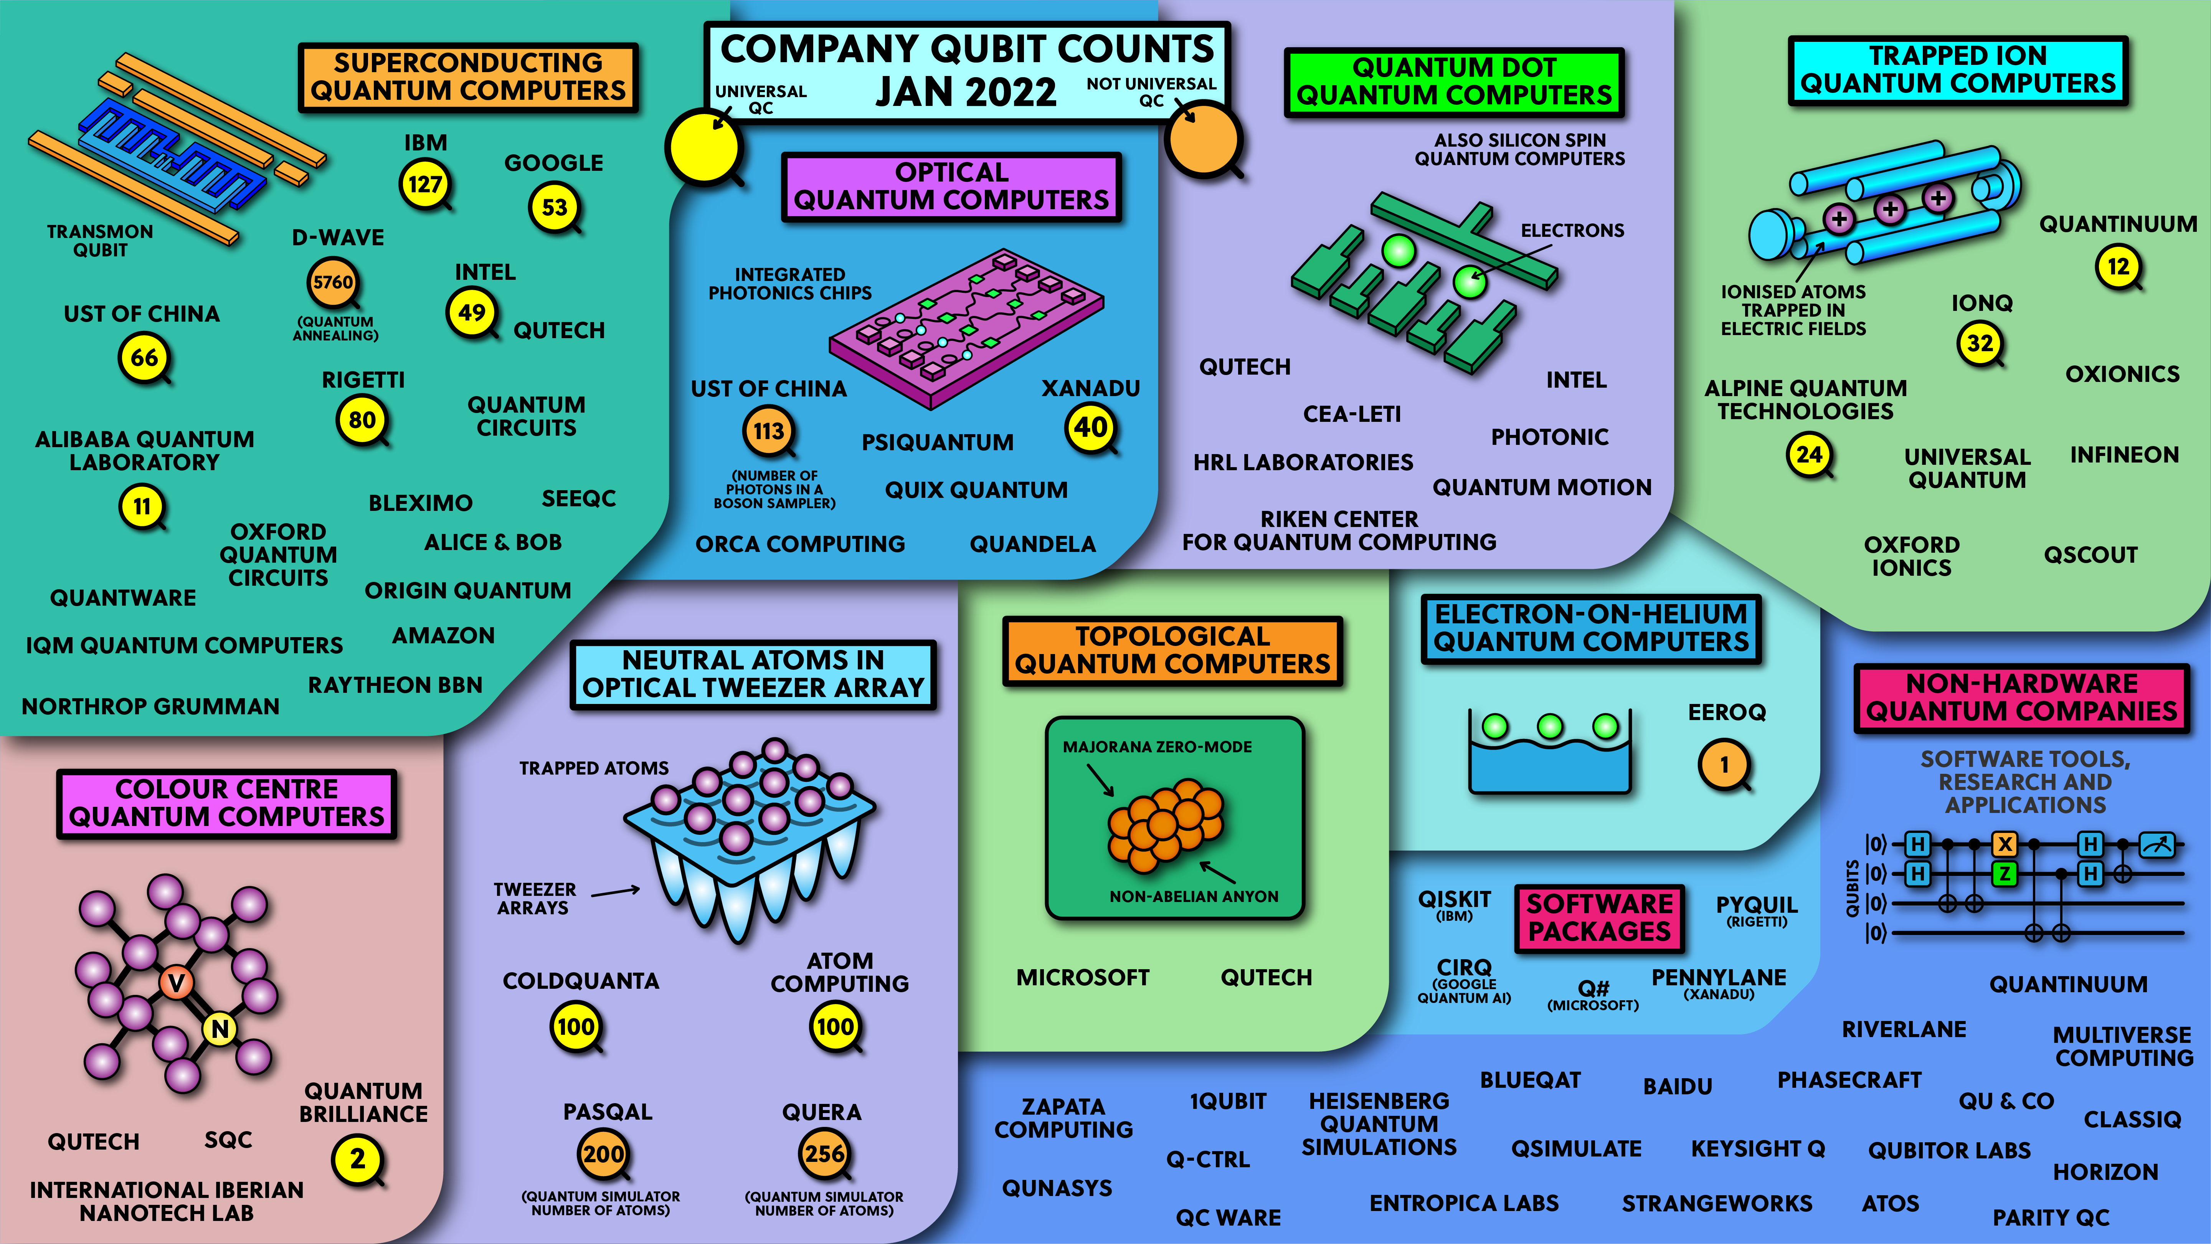
Reference: https://www.youtube.com/watch?v=gcbMKt079l8

Slide 3
Quantum computing roadmap
Implement Error Correction
Show Error Correction gets better with more qubits
Make 1 logical qubit with endless coherency
Make 2 logical qubits with 2-qubit operations
Tile Thousands of logical qubits

Slide 4
Divicenzo’s criteria
For Quantum computation: ------------------------- 1. A Scalable Physical System with well characterized qubits
2. The ability to initialize the state of the qubits to a simple fiducial state
3. Long Relevant Decoherence times
4. A “UNIVERSAL” set of quantum gates
5. A Qubit-specific measurement capability
.
For Quantum Communication:
----------------------------
The Ability to interconvert stationary and flying qubits
The ability to faithfully transmit flying qubits between specified locations

Slide 5
References
Textbook / e-Books: [1]Quantum Computation and Quantum Information, Michael A. Nielsen & Isaac L. Chuang
[2] Investigating Quantum hardware using Quantum Circuits https://learn.qiskit.org/course/quantum-hardware/introduction-to-quantum-error-correction-via-the-repetition-code
Measuring Quantum Computer Performance: [1] Overview and Comparison of Gate Level Quantum Software Platforms
https://arxiv.org/pdf/1807.02500.pdf
[2] Validating quantum computers using randomized model circuits (Quantum Volume)
https://arxiv.org/pdf/1811.12926.pdf
[3] Quantum Volume, Pennylane
https://pennylane.ai/qml/demos/quantum_volume.html
[4] CLOPS definition from IBM
https://arxiv.org/abs/2110.14108

Slide 6
References
Quantum Noise Error Correction:
[1] T. Proctor, K. Rudinger, K. Young, E. Nielsen, R. Blume-Kohout “Measuring the Capabilities of Quantum Computers”, arXiv:2008.11294 (2020).
https://arxiv.org/abs/2008.11294
[2] K. Temme, S. Bravyi, J. M. Gambetta “Error Mitigation for Short-Depth Quantum Circuits”, Phys. Rev. Lett. 119, 180509 (2017).
https://journals.aps.org/prl/abstract/10.1103/PhysRevLett.119.180509
[3] Y. Li, S. C. Benjamin “Efficient Variational Quantum Simulator Incorporating Active Error Minimization”, Phys. Rev. X 7, 021050 (2017).
https://journals.aps.org/prx/abstract/10.1103/PhysRevX.7.021050
[4] T. Giurgica-Tiron, Y. Hindy, R. LaRose, A. Mari, W. J. Zeng “Digital zero noise extrapolation for quantum error mitigation”, IEEE International Conference on Quantum Computing and Engineering (2020).
https://ieeexplore.ieee.org/document/9259940
[5] Variational Quantum-Neural Hybrid Error Mitigation, Shi-Xin Zhang, Zhou-Quan Wan, Chang-Yu Hsieh, Hong Yao, Shengyu Zhang
https://arxiv.org/abs/2112.10380
[6] Error mitigation with Mitiq and PennyLane
https://pennylane.ai/qml/demos/tutorial_error_mitigation.html

Slide 7
Plan for the independent study
Performance Benchmarks
Compare Performances of different quantum simulators
Implement benchmarks and compare different algorithms
Quantum Noise
- Study noise, noise models and error correction methods
Comparison performance of different Quantum Simulators and Error-Mitigation Techniques with a neural network architecture
- Choose a dataset and compare the performance of a given Neural network architectures with different error correction methods and different simulators

